Slide 1

ALCATEL-LUCENT ENTERPRISE
Data Center Switching Solution
Towards a Cloud Ready Enterprise Data Center

Slide 2
Agenda
Market Insight
Alcatel-Lucent Vision for the Data Center
The Alcatel-Lucent Mesh
Competitive Overview
Conclusion

Slide 3
Market Insight
2012 is the year of DC Fabric implementation
What is real, what is not?

Slide 4
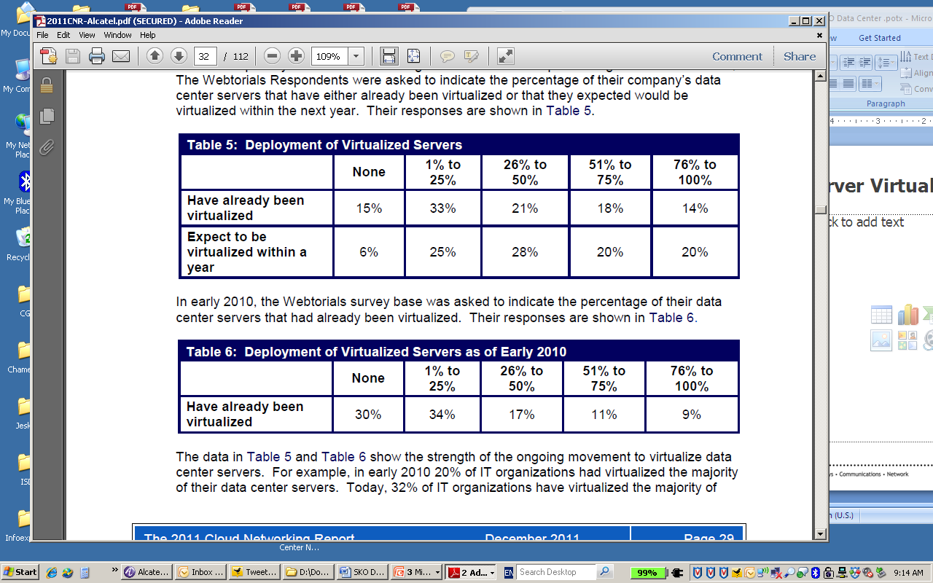
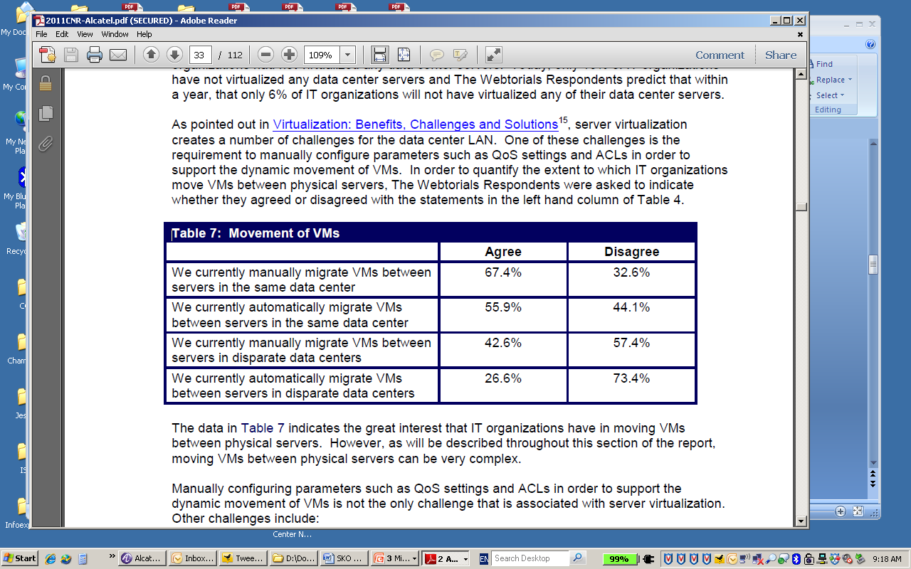
Server Virtualization & DC LAN Projects
Server Virtualization is Happening Now
  Virtual Server Deployments
    Most companies have started: 85%
    Only 14% are near 100% virtualized
Legacy Networks Causing Pain
  Virtual Machine Motion
    Majority is done manually
      Especially between data center sites
    Automation has begun
      Mostly within a single data center site
Ashton Metzler & Associates

Slide 5
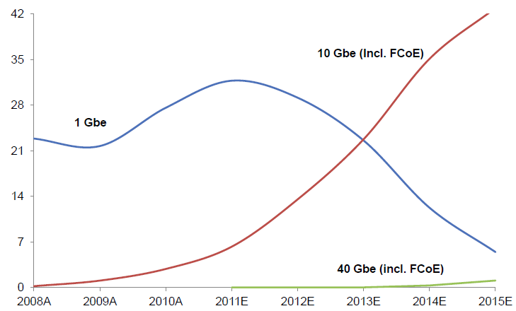
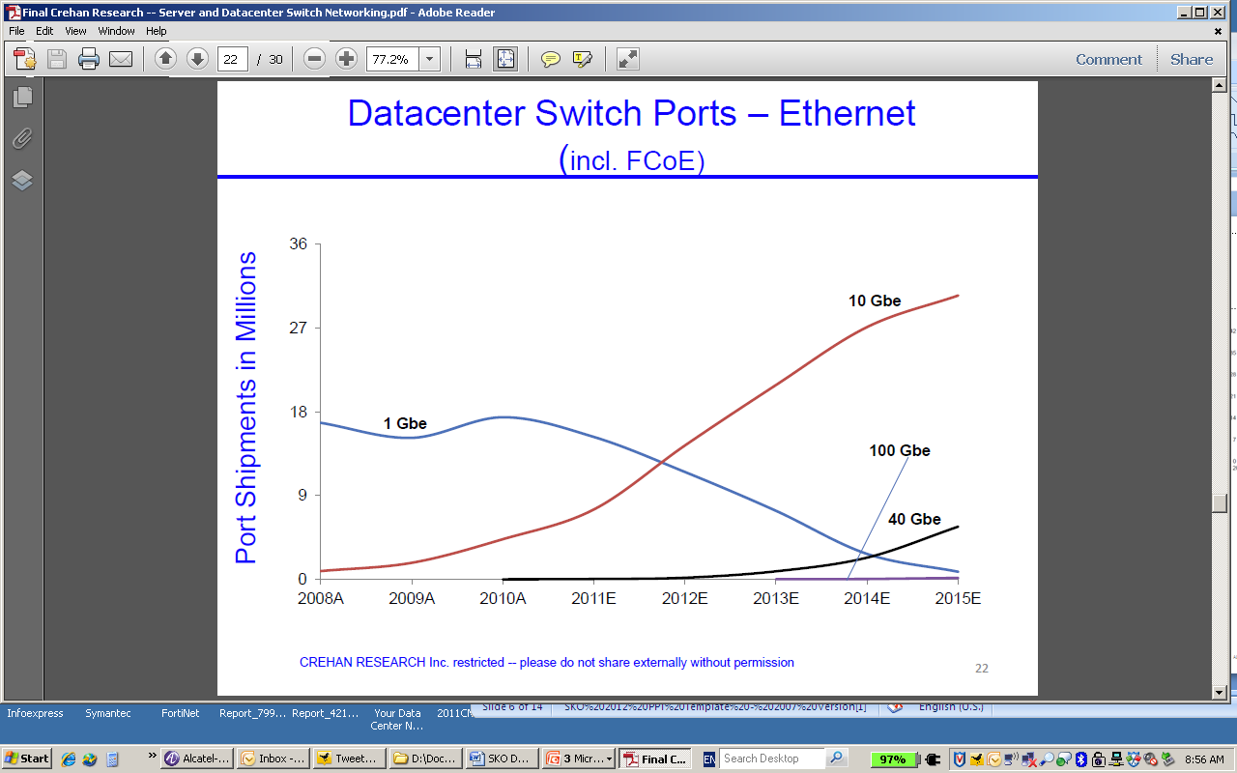
Ethernet 10GigE, 40GigE, 100GigE in DC
2012 is the Year for 10GigE
  10 GigE server ports become the default
  New 10GigE switch ports surpass 1GigE
40GigE is just Beginning, but Important 2012 checkmark
Volume switch ports shipments begin 2013-2014
Volume server port shipments begin 2015
100 GigE takes off in 2014
Server Ethernet Adapter Shipped
Data Center Ethernet Ports Shipped
Crehan Research

Slide 6
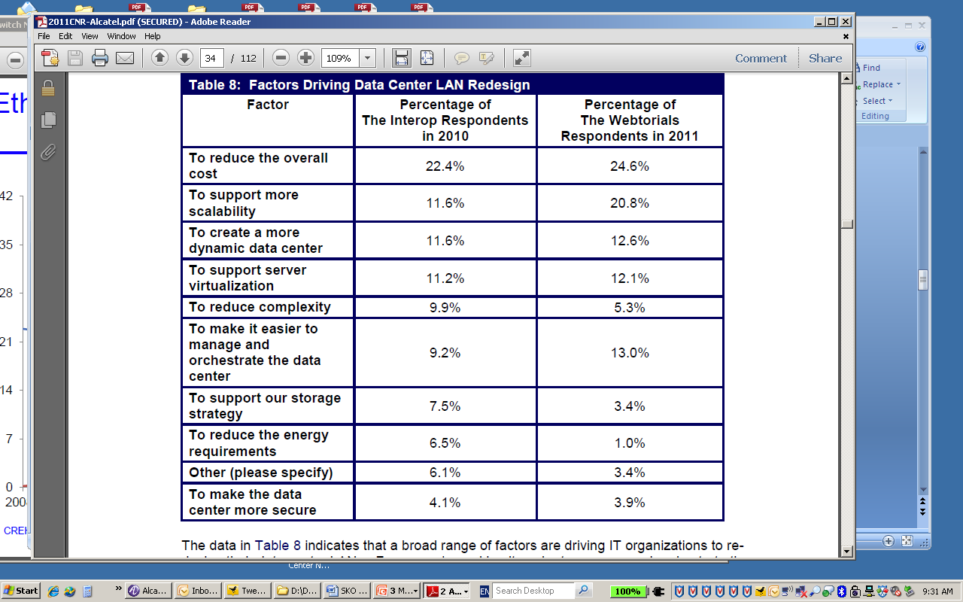
Pain Points Driving DC Switching Redesign
Top Three
Need operational cost reduction
Need increased scalability
Need elasticity in the data center
  Automated resource allocation
  Support for server virtualization
Significant Changes from 2010
More Important
Ease of management
Less Important
Storage convergence strategy
Ashton Metzler & Associates

Slide 7

Vision
Application Fluent Data Center

Slide 8







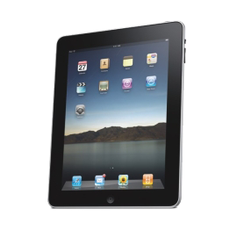


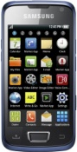

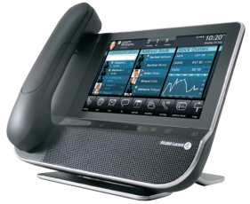
Enabling The Personal Cloud
APPLICATION-FLUENT
NETWORKS

Slide 9
Application Fluent Network
ARCHITECTURE
Resilient Architecture
  SIMPLIFIED, SCALABLE, SECURE
  FOR NEXT GENERATION CLOUD SERVICES-READY NETWORKS
APPLICATION
FLUENT
NETWORK
CONTROL
Automated Control
  COHESIVE CONTEXT DRIVEN POLICY ENGINE
  DYNAMIC PERFORMANCE TUNING
OPERATIONS
Streamlined Operations
  EASY and LOW-TOUCH PROVISIONING
  INTEGRATED SLA MONITORING

Slide 10


Data Center Network Transformation
Client-Server
1 App - 1 Server
AUTOMATION
Business workload agility
Scalability across clouds
Open DC eco-system
VIRTUALIZATION
10G servers
Low latency
Profile for VM Motion
COMPUTING as a SERVICE
Elastic, On-demand computing
Application Plug and Play
End to End performance

Slide 11

Solution
Award Winning: The Alcatel-Lucent MESH

Slide 12
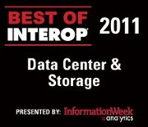

Data Center Network Solution
Customer Needs for 2012
Architecture for Virtualization, Hybrid Cloud adoption
Focus for 2012
Performance, low latency
Scalability
Elasticity
DC Ecosystem
40 GigE Mesh
10 & 40 GigE all wire rate
Shortest Path Bridging
Virtual Chassis
Loss-less Ethernet (DCB)
VEPA & vNP, VM Mobility
Data Center Connect
Leading optical portfolio
End to end management
40 GigE
SPB, VC DCB, VEPA
vNP, VEPA
SPB, VC DCB, VEPA

Slide 13


One Pod A Fully Featured Data Center Fabric
  Flattened Network
  Redundant attachment of servers
  Redundant attachment of storage
  Multi-Path Ethernet with MC-LAG, Shortest Path Bridging, Virtual Chassis
  Automated Virtual Machine mobility (vNP)
  Managed as a single unit with Virtual Chassis technology
  Lossless Ethernet with Data Center Bridging (DCB)
  Edge virtual bridging with Virtual Ethernet Bridging (VEB)
  Storage Convergence: iSCSI, FCoE,FC
Pod
6900
6900
6900
6900
6900
6900
Storage
(iSCSI, FCoE, FC)
Servers

Slide 14
The Full Scale Mesh
Alcatel Lucent Enterprise Mesh
5x40G
Pod
6900
6900
6900
240
6900
Max Server Ports
(2 Core Switches)
14,400
Max Switching Capacity
169 Tbps
Over Subscription Rate*
1.8 :1
Power per Server Port
5 Watts
# 48U Racks
10 Racks
6900
6900
2 μs Latency
5 μs Aggregate Latency*
Any to Any 10/40 GigE connectivity
Virtual Network Profile (vNP)
Fiber Channel over Ethernet
Network virtualized with SPB
  Multi-site private Cloud
  Hybrid Cloud services
*Assuming Server to Server Traffic 70% within a Pod, 20% between Pods and 10% Via Core

Slide 15

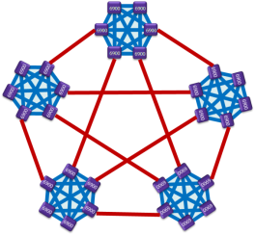
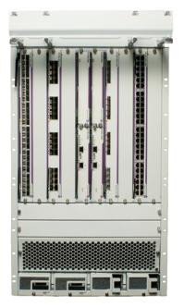

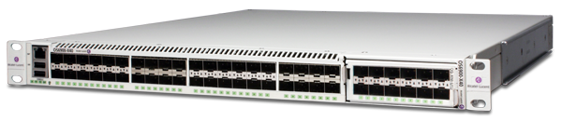

Alcatel-Lucent Mesh
Un-Matched Scalability & Performance
POD
6900
6900
Super POD
6900
240
6900
6900
6900
Alcatel-Lucent Enterprise Mesh
Super POD
Mini POD
POD
1200
2 μs Latency
6900
6900
6900
6900
Super POD 12
Super POD 1
Super POD 2
240
Super POD 3
Mini POD
6900
1200
6900
120
5 μs Aggregate Latency
6900
6900
4 μs Latency
Max Server Ports
(2 Core Switches)
14,400
Max Switching Capacity
169 Tbps
Over Subscription Rate*
1.8 :1
Power per Server Port
7 Watts
# 48U Racks - 10 Racks
2 μs Latency
4 μs Latency
120
2 μs Latency
2 μs Latency
Notes:
In 80% of the datacenter / server room deployments, server virtualisation is applied. 10G is the trend that is happening today, and together with the traffic pattern changing from N-S to E-W is pushing the network to scale. The next wave of virtualisation is the dynamic move of virtual machines to increase power- and CPU efficiency. These moves requires the network to dynamically cope with these moves to assure the proper QoS for each service on each VM

Slide 16

Applications Managed as a Service
The Network Understands
Each Application
  Provisioning requirements
  Security profile
  Expected quality of service levels
  Priority of the application for the corporation
  Latency and jitter requirements
The Network Automatically
Manages Applications
  Automated binding of vNP to virtual machine
  Automatic discovery of virtual machine location
  Automatic provisioning of applications
  Network configuration follows virtual machine moves
  Dynamic tuning of QoS parameters
  Network requested VM moves to minimize latency
Virtual Network Profile
Application
Network Provisioning
Security Requirements
Quality of Service
Priority
vNP
Data Center Fabric

Slide 17
Alcatel-Lucent Mesh
Automated VM Mobility
6900
6900
vNP1
vNP2
vNP
6900
6900
vNP
VM Classification
Profile Association
  QOS
  Security
  Priority
  Bandwidth
6900
Automated VM Mobility
Network Follows the VM
Transparent to Inter or Intra DC Mobility
6900
6900
6900
6900
6900
6900
6900
VM1
VM2
Notes:
In 80% of the datacenter / server room deployments, server virtualisation is applied. 10G is the trend that is happening today, and together with the traffic pattern changing from N-S to E-W is pushing the network to scale. The next wave of virtualisation is the dynamic move of virtual machines to increase power- and CPU efficiency. These moves requires the network to dynamically cope with these moves to assure the proper QoS for each service on each VM

Slide 18






The Cloud Ready Enterprise Data Center
Key Element of AFN Vision
Private Cloud
  Fabric is one logical structure
  Can be physically spread across several sites
  Can define separate departmental data centers
Public Cloud Services
  Service provider services seamlessly delivered from Cloud onto the fabric
  End to end visibility on service quality
Enabling Technology
  Shortest Path Bridging cloud compatible protocol
  Virtual Network Profile vNP for orchestration and elasticity
CloudBand
Cloud Data Center
WAN
Service Router
Alcatel-Lucent Mesh
Finance
HR
Production
Corporate Data Center Site 1
Corporate Data Center Site 2
Multi-Site Private Cloud
Notes:
A key element of Alcatel-Lucent’s vision of application fluency for the data center is the transformation of the corporate data center from several separate sites into a private cloud. This means that applications can be transparently delivered from any data center site and resource utilization can be optimized due to agility and elasticity that extends across all the data center sites. At the center of this capability is the Alcatel-Lucent Mesh and Pod providing a data center fabric that is one logical structure that can physically be spread across several sites. This applies to large deployments with a full Mesh or smaller deployments with only the Pod. Additionally, the Alcatel-Lucent Mesh can be partitioned into virtual data centers allowing the definition of different data centers for specific departments. This enhances performance, security and eases management.
The underlying enabling technology for this transformation is the use of Shortest Path Bridging and the Virtual Network Profile. SPB is compatible with PBB used by service providers for providing WAN links and delivery of Cloud Services. SPB also natively allows for the definition of virtual data centers – including providing specific QoS treatment of each virtual data center for WAN traversal. SPB is also compatible with all the OAM tools used for PBB enabling an end to end view on application delivery for Cloud based services. The vNP enables the fabric to automatically react to Vm motion to provide the desired agility and elasticity for application delivery for both applications provided within the corporate data center and Cloud services.
Alcatel-Lucent Enterprise is also working with Alcatel-Lucent on the newly announced CloudBand solution to ensure interoperability and end to end orchestration of Cloud services to the enterprise – small and large.
In short whether an enterprise deploys the Pod or the complete Mesh – their data centers when transformed into a private cloud are ready for high quality delivery of Cloud services.

Slide 19

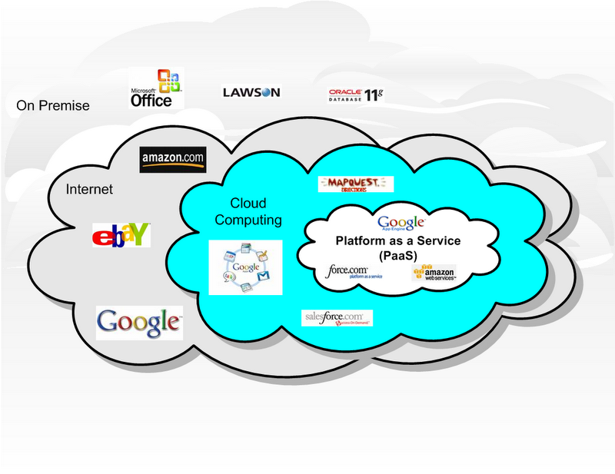



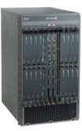

Alcatel-Lucent Mesh
Multi-Site Cloud Solution
Optical backbone
Long distance
Secured/Encrypted
Unsecured
Optical SAN/MAN
40G/100G
IP Backbone
MPLS
PBB
SPB
Secured Public/Private/Hybrid Cloud
Notes:
In 80% of the datacenter / server room deployments, server virtualisation is applied. 10G is the trend that is happening today, and together with the traffic pattern changing from N-S to E-W is pushing the network to scale. The next wave of virtualisation is the dynamic move of virtual machines to increase power- and CPU efficiency. These moves requires the network to dynamically cope with these moves to assure the proper QoS for each service on each VM

Slide 20

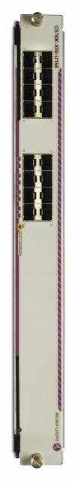
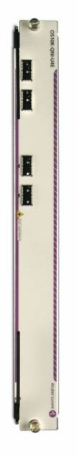



OmniSwitchTM 10K
Core and End of Row Data Center Switch
Leader in Raw Performance
Virtual Chassis: 512x10GigE or 128x40GigE wire rate, non blocking
Single System: 256x10GigE or 64x40GigE wire rate, non blocking
Layer2, Layer3, uni-cast, multi-cast
Verified by Independent Tests (Lippis / Ixia)
5Gbyte of buffer per card and 15k Queues system-wide
Platform to Evolve to 100GigE
Virtual Chassis
Lossless Ethernet (FCoE)
Platform support for Latest IEEE standards
DCB IEEE 802.1Qbb, IEEE 802.1Qau and IEEE 802.1Qaz
16 Port 10 GigE
4 Port 40 GigE
40 GigE Line Cards
  4 x 40GigE
  8 x 40GigE
10 GigE Line Cards
  8 x 10GigE + 8 x 1GigE
  16 x 10GigE & 32 x 10GigE

Slide 21
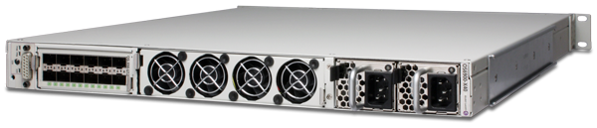
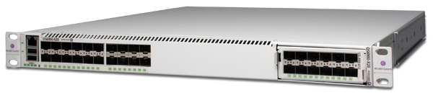



OmniSwitchTM 6900
Core and Top of Row Data Center Switch
Leader in Raw Performance
Upto 64 ports of 10GigE (1.28Tbps)wire rate, non blocking
Layer2, Layer3, uni-cast, multi-cast
Verified by Independent Tests (Lippis / Ixia)
Front to Back and Back to Front cooling options
20 and 40 10GigE fixed ports model
Optional module for utmost flexibility and future proofing
OmniSwitch OS6900-X40 (front / back views)
OmniSwitch OS6900-X20 (front)
Lossless Ethernet (FCoE)
Platform support for Latest IEEE standards
DCB IEEE 802.1Qbb, IEEE 802.1Qau and IEEE 802.1Qaz
12 Port 10 GigE
3 Port 40 GigE
40 GigE Line Cards
  3 x 40GigE
  2 x 40GigE + 4x 10GigE
10 GigE Line Cards
  4 x 10GigE
  12 x 10GigE

Slide 22
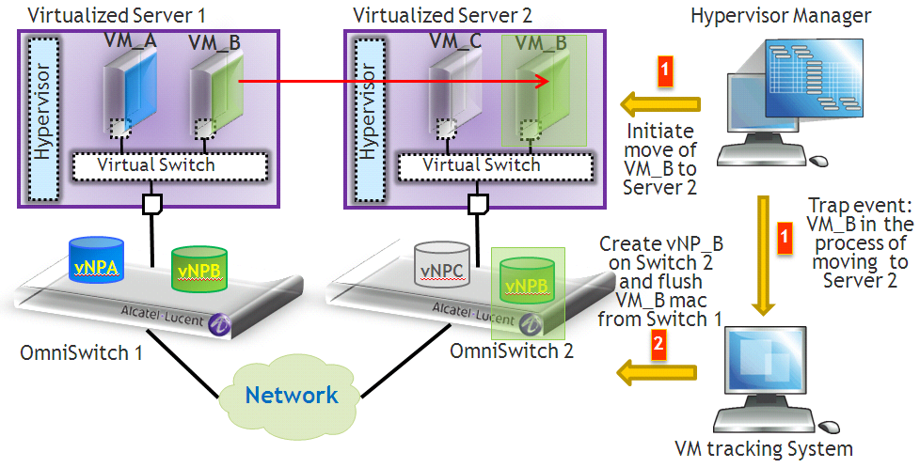




OmniVista 2500 Virtual Machine Manager
Mesh Automatically Adapts
with VM Movement
  Visibility
  Provides a unified dashboard of switches, ports, hypervisors and virtual machines
  Live and historical data tracking and logging
  Provisioning
  Definition of bindings between VM and vNP
  Movement
  Migration of vNP to new switch
    Security & QoS parameters, VLAN configuration
    Add, migrate, remove
  Integration
  vCenter, Hyper-V, XENServer and KVM
OmniVista 2500 VMM

Slide 23
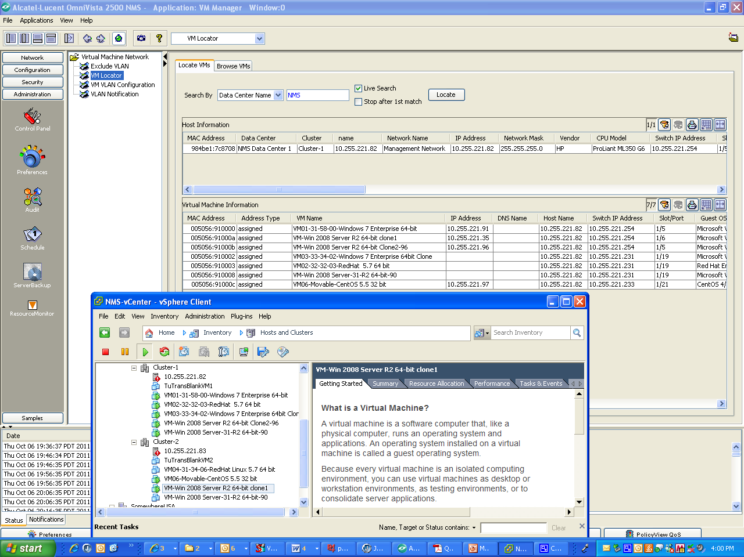
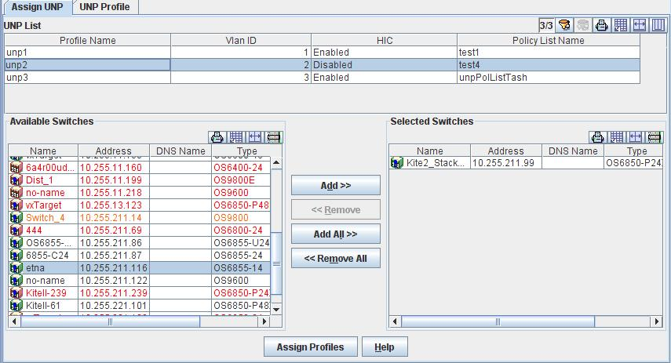
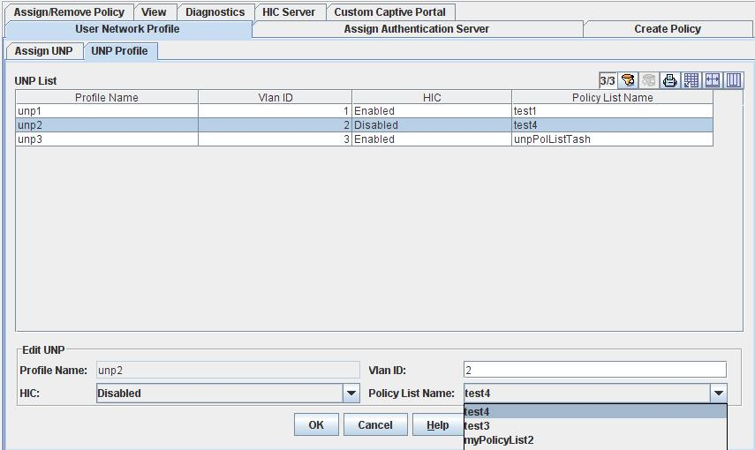
Alcatel-Lucent Mesh
Application Provisioning & Visibility
VM Live/Historical Search
6900
6900
vNP1
vNP2
vNP2
vNP
vNP
6900
6900
vNP
6900
6900
vNP
vNP
6900
6900
6900
vNP
6900
6900
6900
VM1
VM2
Bulk Provisioning across the fabric
Create vNP Profiles
Data Center Inventory seen through 2 Interfaces: VMM Locater & vCenter
Notes:
In 80% of the datacenter / server room deployments, server virtualisation is applied. 10G is the trend that is happening today, and together with the traffic pattern changing from N-S to E-W is pushing the network to scale. The next wave of virtualisation is the dynamic move of virtual machines to increase power- and CPU efficiency. These moves requires the network to dynamically cope with these moves to assure the proper QoS for each service on each VM

Slide 24


























A Strong Partner Eco-System
Management
Ionix
Server Virtualization
Server NICs
Storage
Virtual Desktop, ADC, WAN Optimization
Hh
Data Center Hypervisor
Rack Mounted servers
Blade servers
Fiber Channel Storage
iSCSI storage
Notes:
Our Data Center solutions include Switching and Interconnect.
Alcatel-Lucent provides a high performance & density switching solution for the data center that allows a two tier architecture with support for 10G immediately with a 40G/100G ready architecture.
Disaster recovery and load balancing between data center sites is also made simple with integrated management across the data center switching fabric and the WAN.

Slide 25
Meeting Key Customer Requirements for 2012
Provide Choice, Not Lock-in
Unmatched scalability & performance
  From 100’s to over 10,000 server facing ports
  Low latency server to server traffic (5µs)
  High bandwidth (40GigE)
Market leading return on investment
  Smallest capital and operation cost per server port
Provides low risk, linear cost option
  Can start with small single Pod deployment, no forklift
Provides elasticity for the data center
  Automated VM mobility for balancing server workload
  Enables automated VM mobility between DC sites
Provides choice of storage convergence
Services specific to data center customers

Slide 26

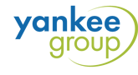

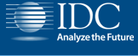
Established Leadership in Data Center Networks
Analyst Feedback
I see some significant software improvement here...On Citrix partnership, there’s lots to gain for both sides.
Great progress on winning customers….ALU-E has a true ‘fabric’…tremendous progress in a short time. ALU-E has a definite advantage with these early wins...There isn't a real leader in the fabric market.
As a technology company, you are kicking the butt of the others…This is one of the best solutions out there…. specs are tremendous…on cloud enablement: “You guys are leading the pack.
Good proof points that ALU-E is continuing with its vision- ALU-E makes compelling case for SPB – exciting announcement - ALU-E has something unique with scalability - 40GigE important checkmark

Slide 27

Competitive Overview
Market Leading Solution

Slide 28
Market Leading Fabric
~1000 Servers, 1920 Server Facing Ports

Slide 29
Solution Economics 1000, 500 & 120 Servers
Capital Coast Per Ser Per Facing Port
~1000 Servers, 1920 Server Facing Ports

Slide 30
Solution Economics 1000, 500 & 120 Servers
5 YR Power Consumption

Slide 31
Solution Economics 1000, 500 & 120 Servers
Capital Cost Per Server Facing Port
5 YR Power Consumption
For 1000 Servers ALUE is $905K Less Than Cisco over 5YRs

Slide 32

Enabling the Personal Cloud for Enterprises

Slide 33
Alcatel-Lucent Data Center Switching Solution
Key Highlights of our Application Fluent Approach
Low Latency, High Availability Mesh Design
Two-tier fabric design
Application programmability and visibility
Automatically recognizes adds/move/changes of virtual machines
Pay-as-you-grow scalability
Architecture enabled with small initial investment
Cloud-ready
Wire-rate capacity
Integrates into existing infrastructure with stands-based interoperability – No rip/replace needed
End-to-end resiliency
Near Linear scalability to over 14000 servers facing ports
Supports all hypervisor technologies
Shortest Path Bridging (SPB) for cloud integration
Integrated management and OSS tools

Slide 34
Enabling The Personal Cloud
Focus on user quality of experience and smart business transformation
ALUE executing on AFN Vision with a comprehensive network blueprint to enable the Personal Cloud

Slide 35


twitter.com/ALUEnterprise
FOLLOW US
facebook.com/ALUEnterprise
youtube.com/user/enterpriseALU
www.linkedin.com --Group Alcatel-Lucent Enterprise

